Slide 1
Project 2: COVID Data Analysis with Spark
Derrick Lin, Dylan Stuart, Tanka Gautam

Slide 2
Tech Stack
Scala
Spark
Dataframes
SQL
HDFS
Excel for graphing

Slide 3
Goal
Find trends in the COVID data
Our question: what factors correlate with death percentage (deaths per confirmed case)? Hypotheses:
Date of first sighting
Peaks in cases (date and height of largest peak)
Geography (latitude and longitude)

Slide 4
Death Percentage
The dependent variable we’re trying to find a correlations with
Total deaths / total confirmed cases, for each country
Example: Paraguay
6572 deaths
282543 confirmed cases
2.33% death rate
Most countries are around 0-5%. Only five countries are higher:
Yemen (19.44%)
Mexico (9.25%)
Syria (7.00%)
Sudan (6.92%)
Egypt (5.87%)

Slide 5
First Sighting
“First sighting”: the first date for each country with number of confirmed cases > 0
First sighting data from covid_19 data file
Example: Paraguay
First sighting: 03/08/2020

Slide 6
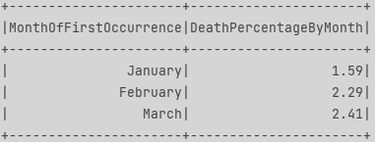
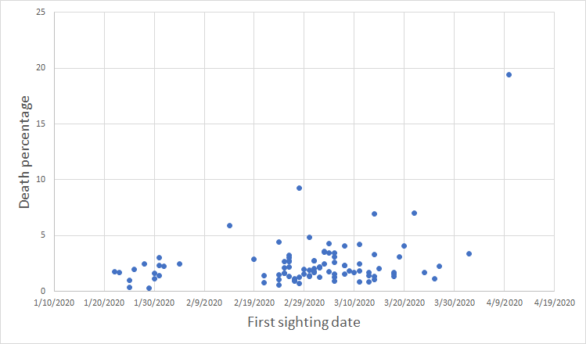
First Sighting: Results
Later first sighting corresponds to a higher death rate
This graph was for countries that had at least 1000 deaths

Slide 7
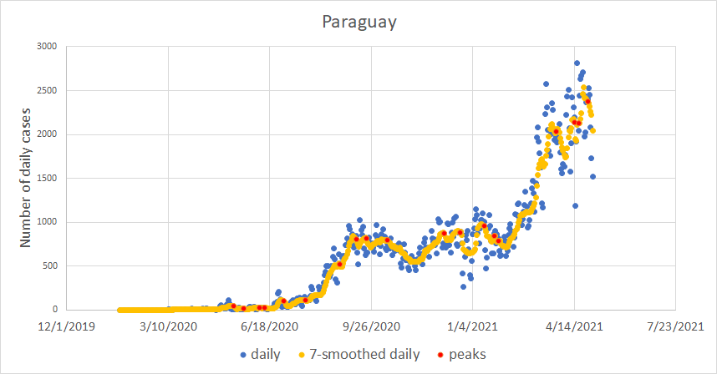
Peaks
Start with total confirmed cases data for each country from time_series_covid_19_confirmed.csv
Subtract and get 7-day moving average to get daily cases in each country
Find peaks = relative maxima
Ignore all peaks with less than 10 daily cases
For each country, consider the peak with the most daily cases
Example: Paraguay

Slide 8
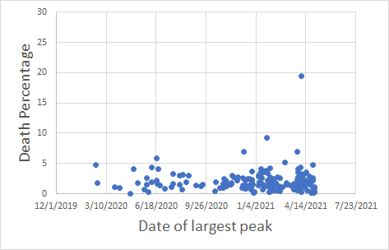
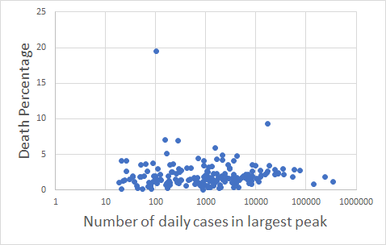
Peaks: Results
Some countries have no peaks
e.g. Marshall Islands, with not enough cases to reach the “10 daily cases” minimum
In general, no clear trend with date or height of the largest peak
Largest peak size is either not correlated, or there are other confounding factors

Slide 9
Geography
Count the number of countries with confirmed cases
Group countries by latitude and longitude range
Find and name where geographical region lies based on latitude and longitude
Ex: Latitude (10 and 90) and Longitude(-180 and -25) falls in North America region
Calculate deaths percentage within specific latitude and longitude points

Slide 10
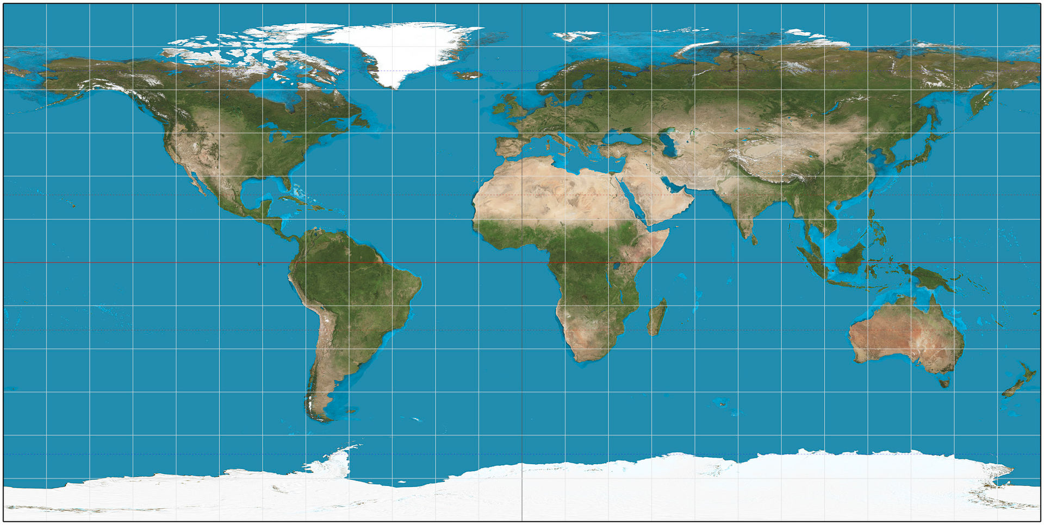
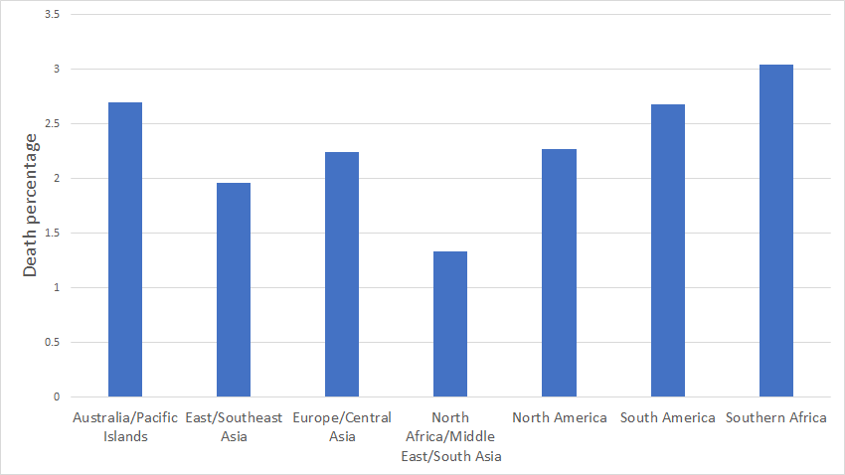
Geography: Results
Group latitude and longitude into 7 geographical regions
Bar graph to show deaths percentage within the regions
North America
Europe/
Central Asia
East/ Southeast Asia
N. Africa/ME/
South Asia
South America
Southern Africa
Australia/Pacific Islands
Map image source: https://en.wikipedia.org/wiki/Equirectangular_projection#/media/File:Equirectangular_projection_SW.jpg

